Slide 1



Project R&D 2024/2025
SDN-enabled F-FDN
PROGRESS PRESENTATION
Student : QIAN Yicheng, CONG Linxiang
Supervised by : NAZIM AGOULMINE
Nov,15 2024

Slide 2


TABLE OF CONTENT
01
04
Traditional Model
Next week
02
F-FDN Model
03
SDN-enabled F-FDN Model
Project R&D

Slide 3
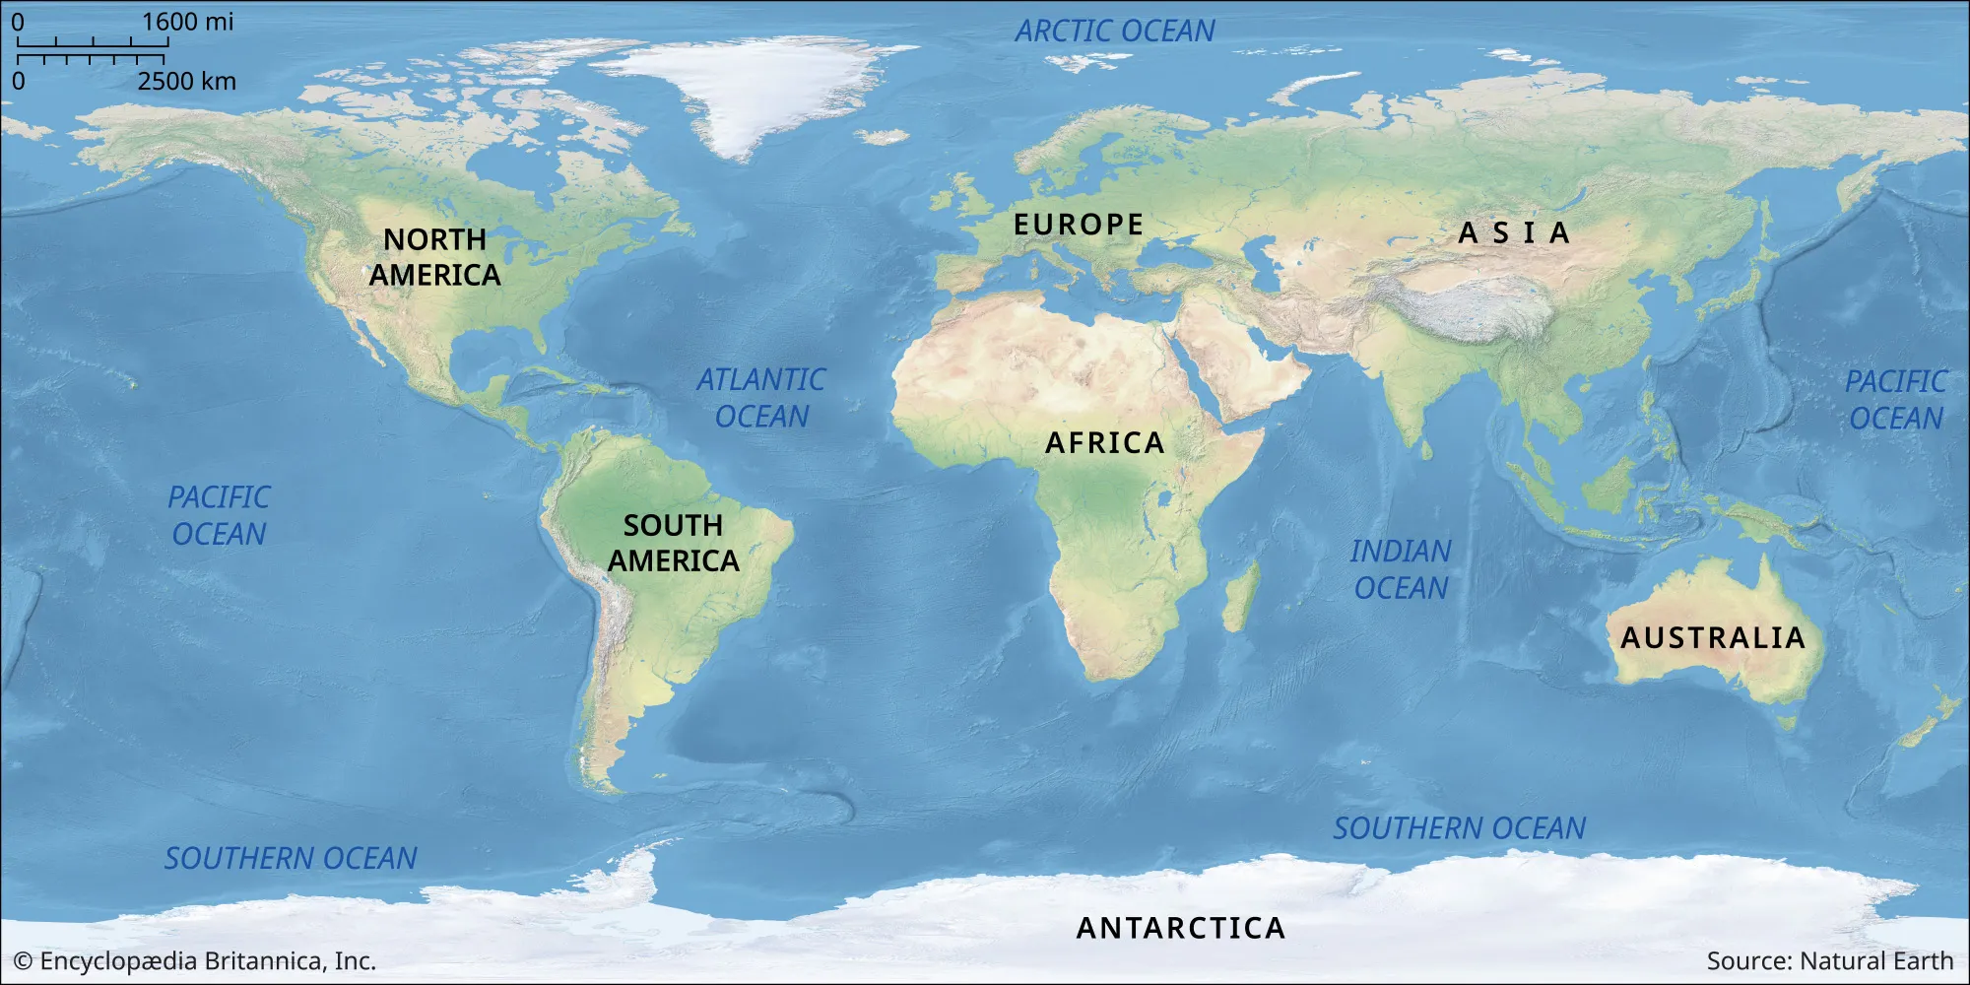

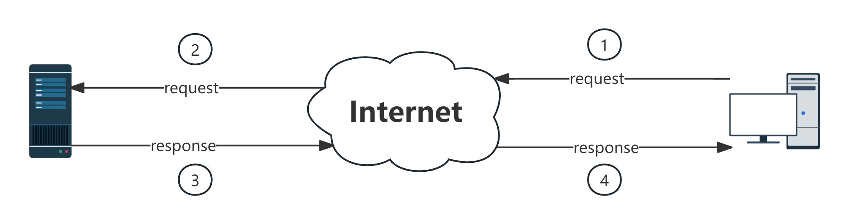

Traditional Model
Image downloaded from https://www.britannica.com/science/world-map

Slide 4
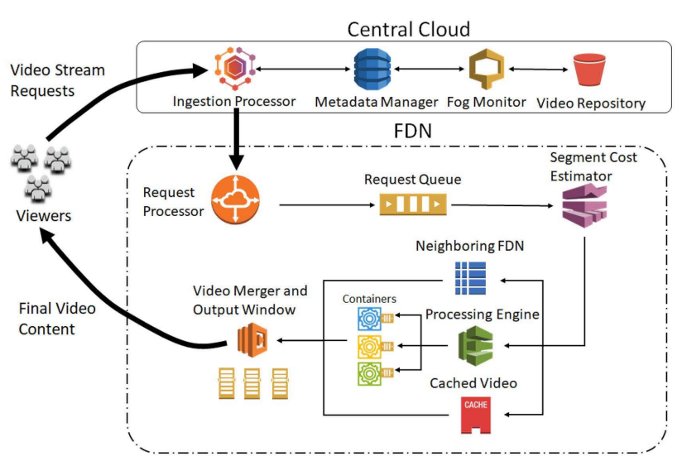
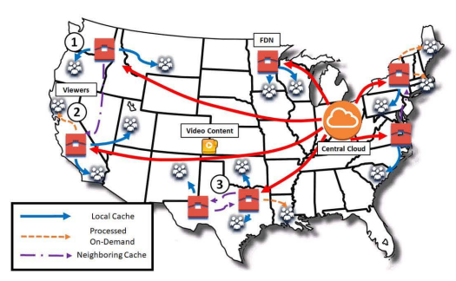
F-FDN Model
Federation Fog Delivery Network
Images from F-FDN: Federation of Fog Computing Systems for Low Latency Video Streaming, 2019

Slide 5
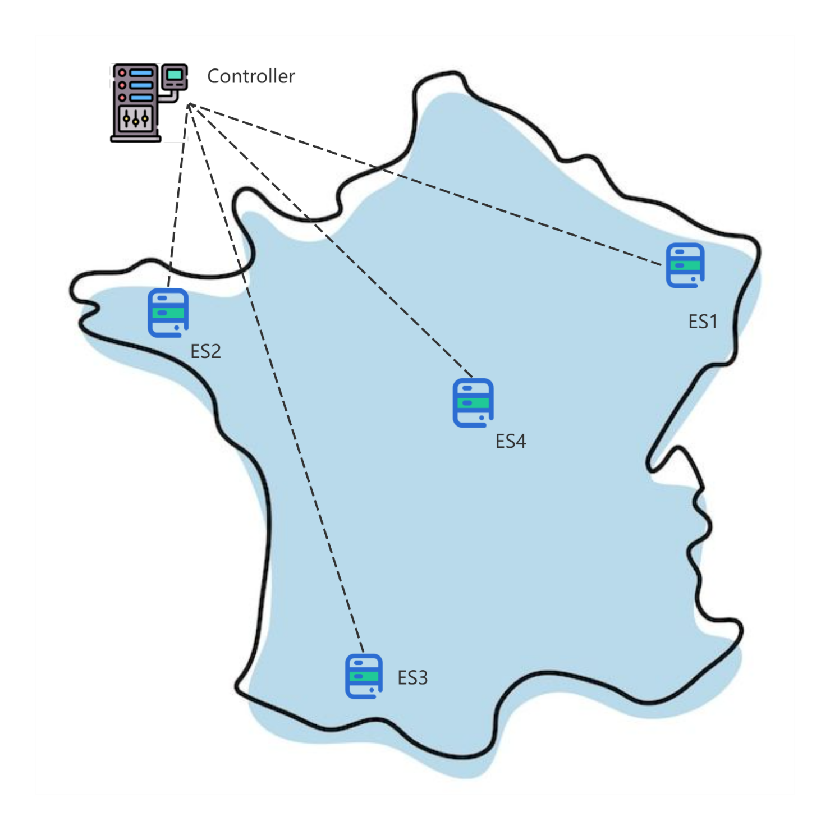

SDN-enabled F-FDN
Details of the proposed solution
ES = Edge Server
SDN controller has knowledges about the location of all video frames(1080p, 4K, 480p, 720p), we can name it as Video Information Base(VIB).
For example, the controller knows the 5th frame(1080p) of the film “The Fast And The Furious 8” is stocked in ES1.
The data structure for presenting VIB is still up for debate.
segments
Outline France map downloaded from https://www.istockphoto.com/

Slide 6
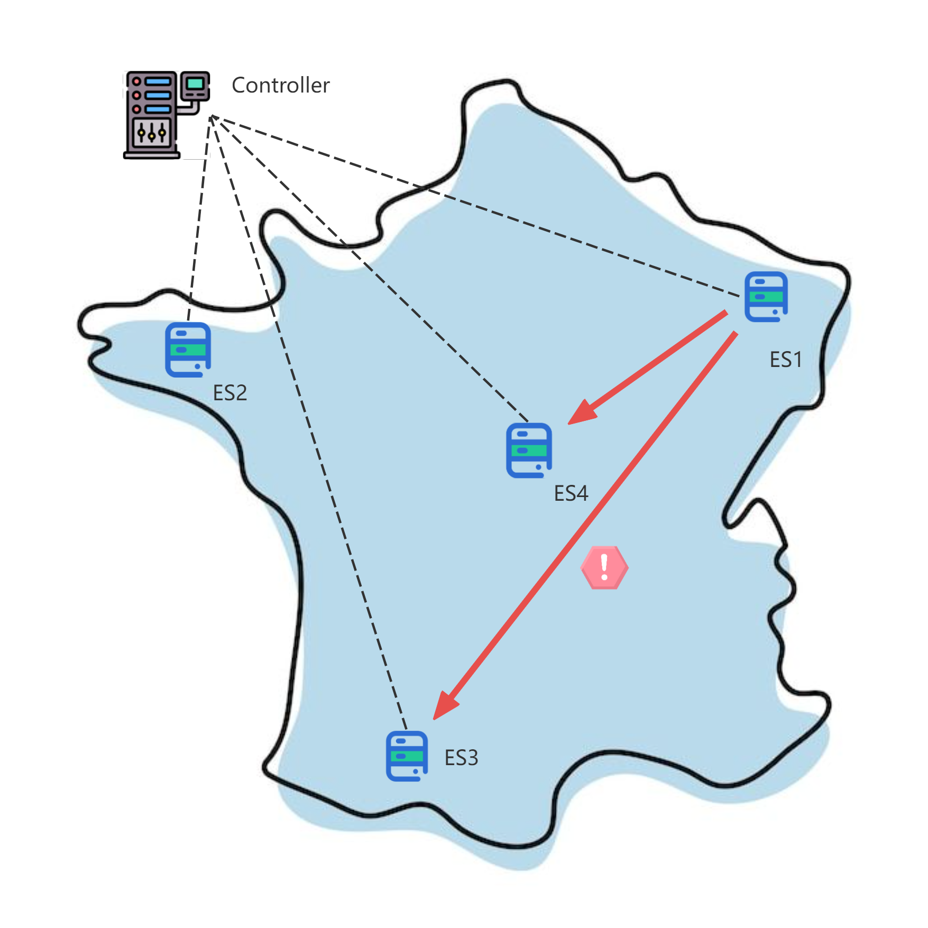
SDN-enabled F-FDN
Details of the proposed solution
When A local FDN does not find the next video frame, it asks SDN controller, SDN controller searches relevant information in VIB.
Prioritize the search starting from FDNs in the local vicinity and then searching to a larger area. For example, it will asks first to ES4 instead of ES3.
The local FDN asks to the FDN who has the next frame to return the next frame. Once the local FDN received it, caches it. It will return this cache to client directly.
If the local FDN has the frame, but it is not conformed to the asked quality of frame, it processes the quality of frame, for example from 4K to 720p.
Outline France map downloaded from https://www.istockphoto.com/

Slide 7
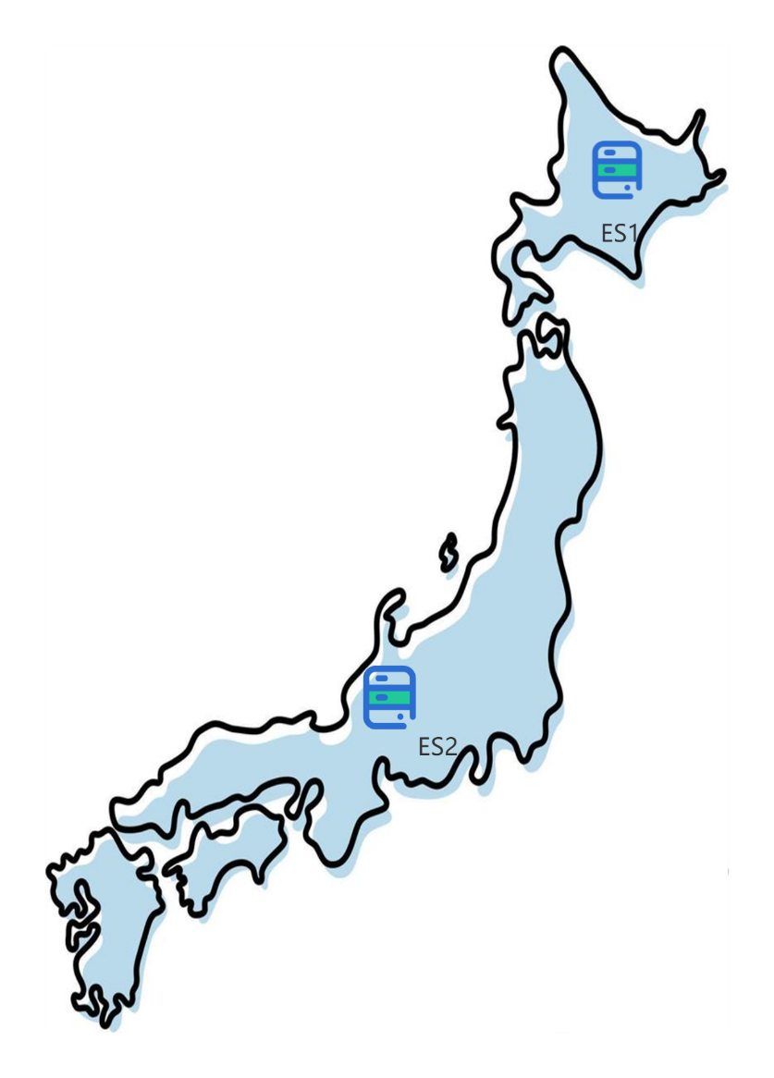
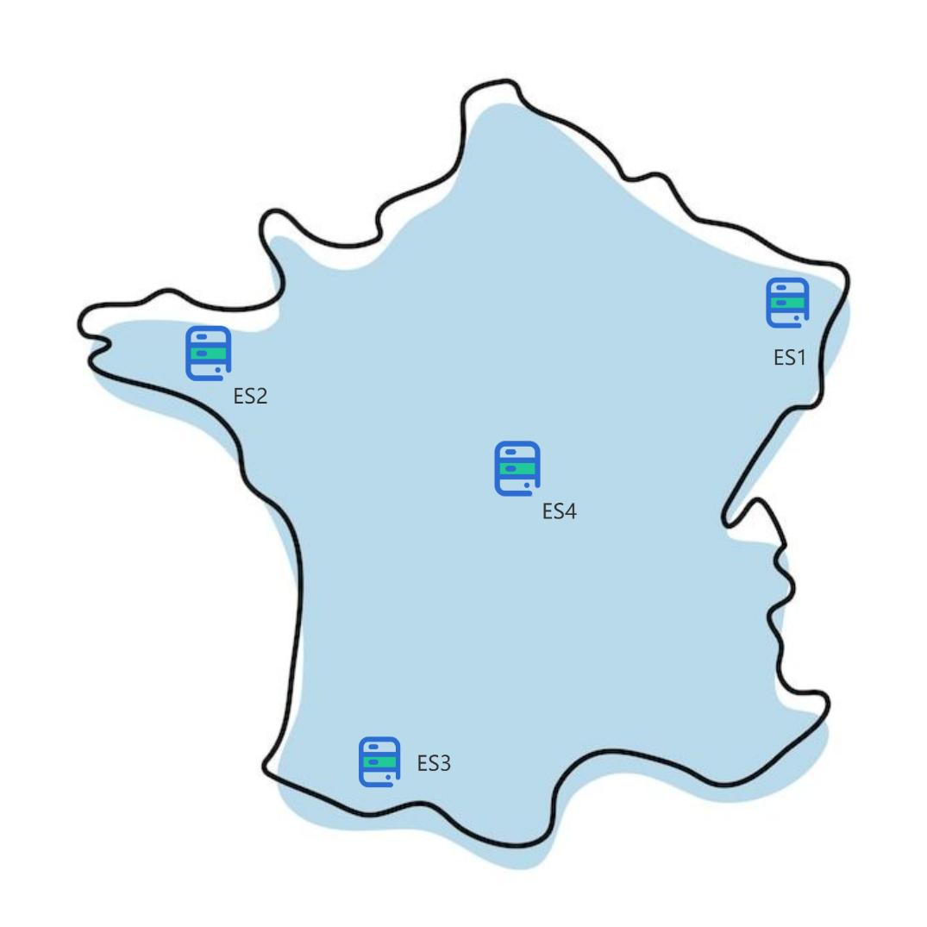
SDN-enabled F-FDN
Details of the proposed solution
Different regions have different cultures.
It is impossible for an edge server to store the vast majority of movies in the world today.
So a local FDN caches local popular video frames, for example the most popular videos in 2024 : “Sous la Seine”, “The Kingdom” and Recorded video of the Olympics, etc.
Outline France and Japan map downloaded from https://www.istockphoto.com/

Slide 8
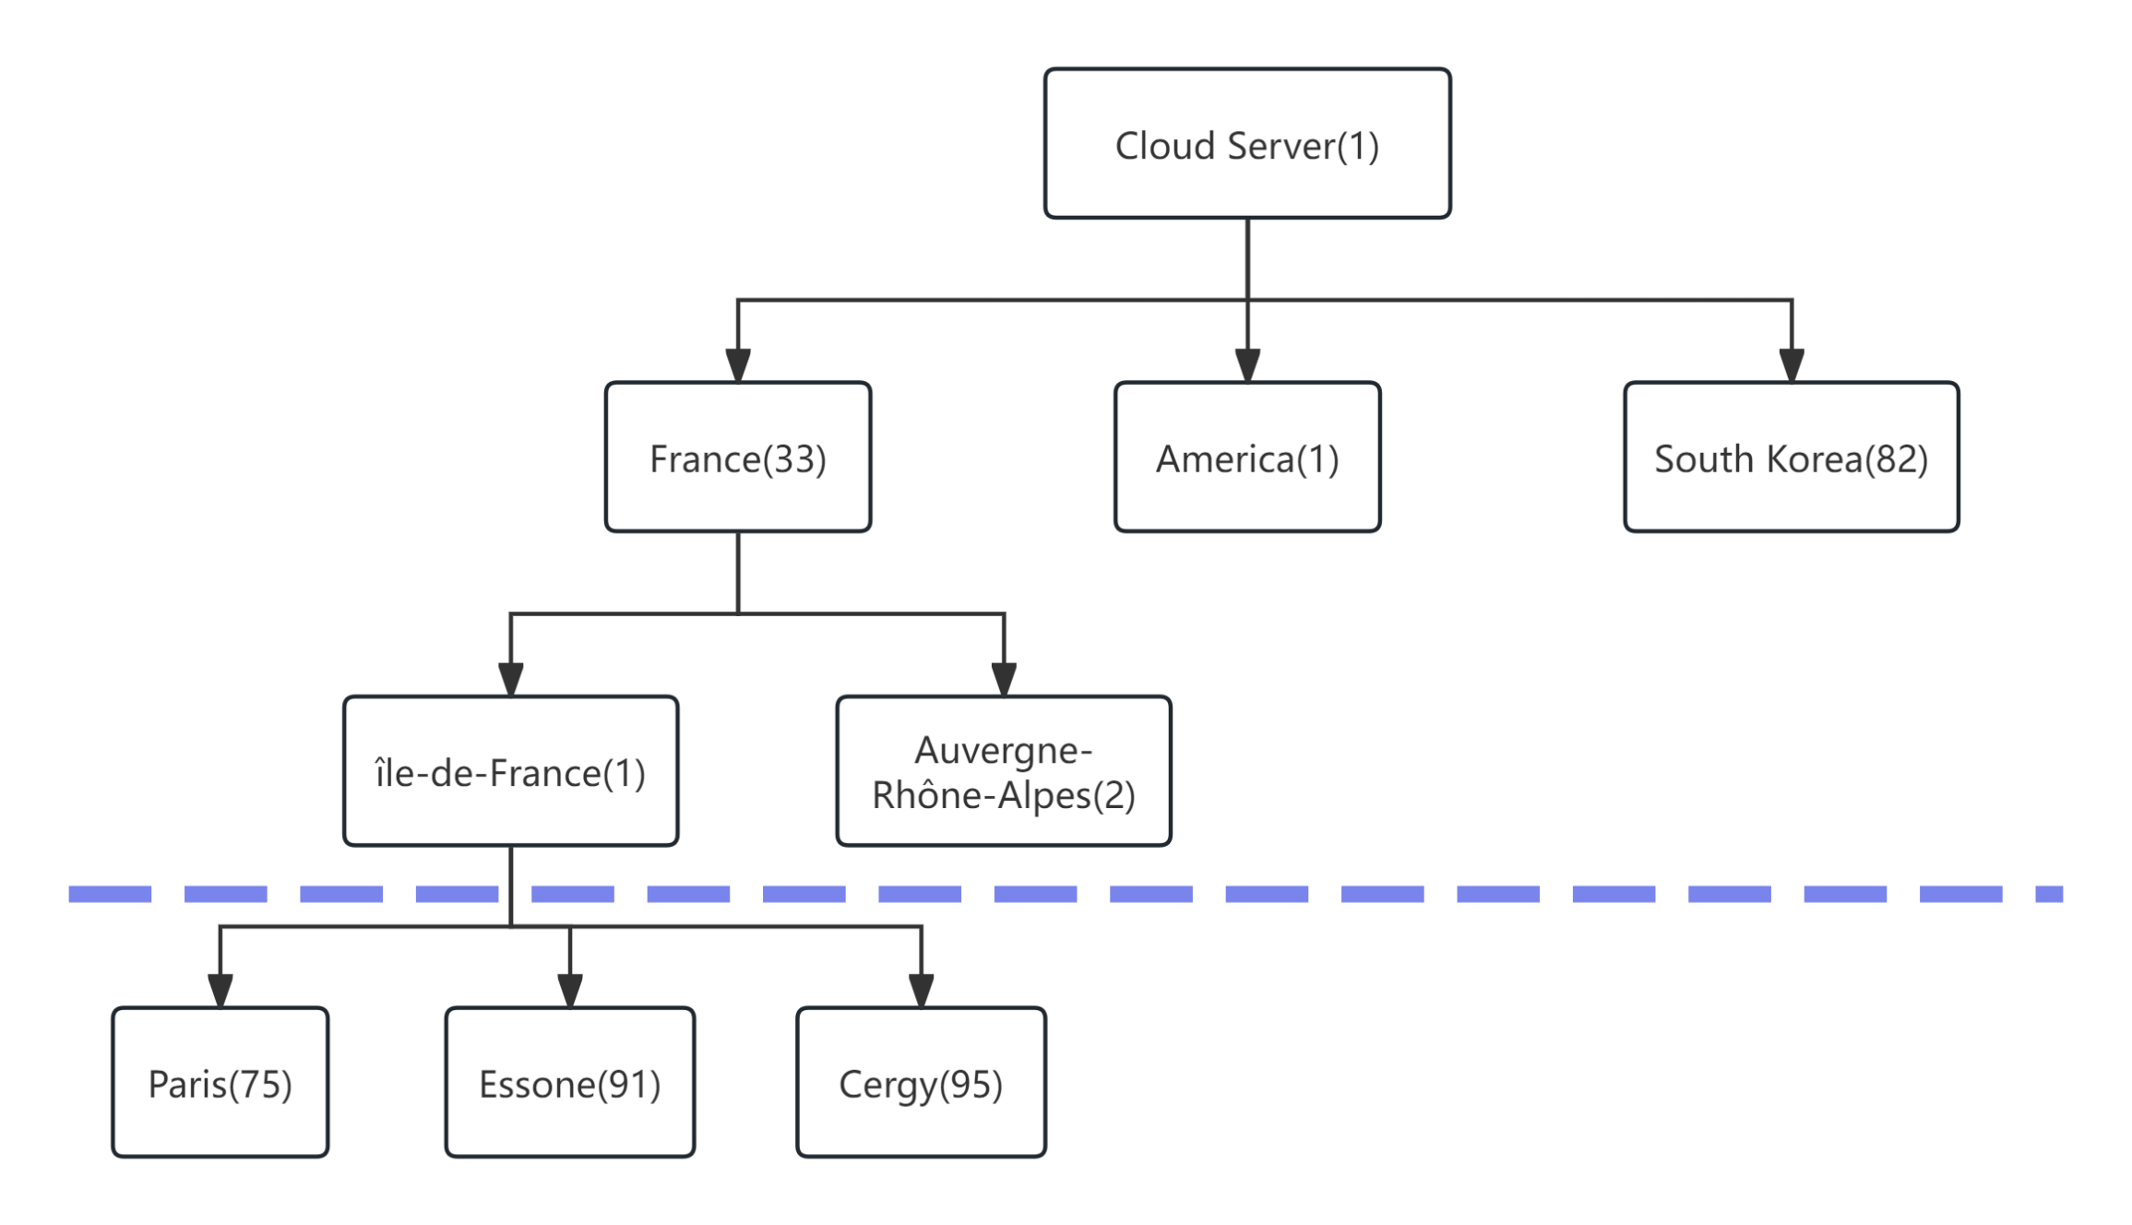
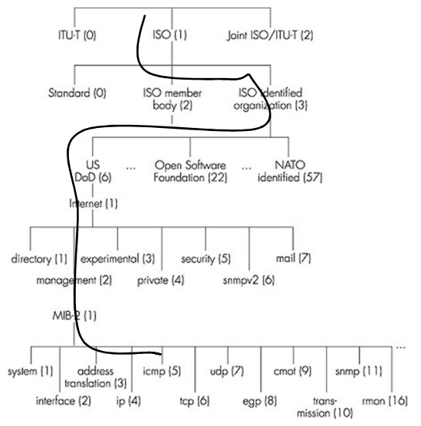
SDN-enabled F-FDN
Details of the proposed solution
How the SDN controller locates the closest ES in a same region/country?
An envisaged idea depending on granularity.
We introduce the same idea as OID (Object Identifier).
Two ES in the same region/country have the same “OID”.
A ES deployed at île-de-France, its “OID” is 1.33.1

Slide 9
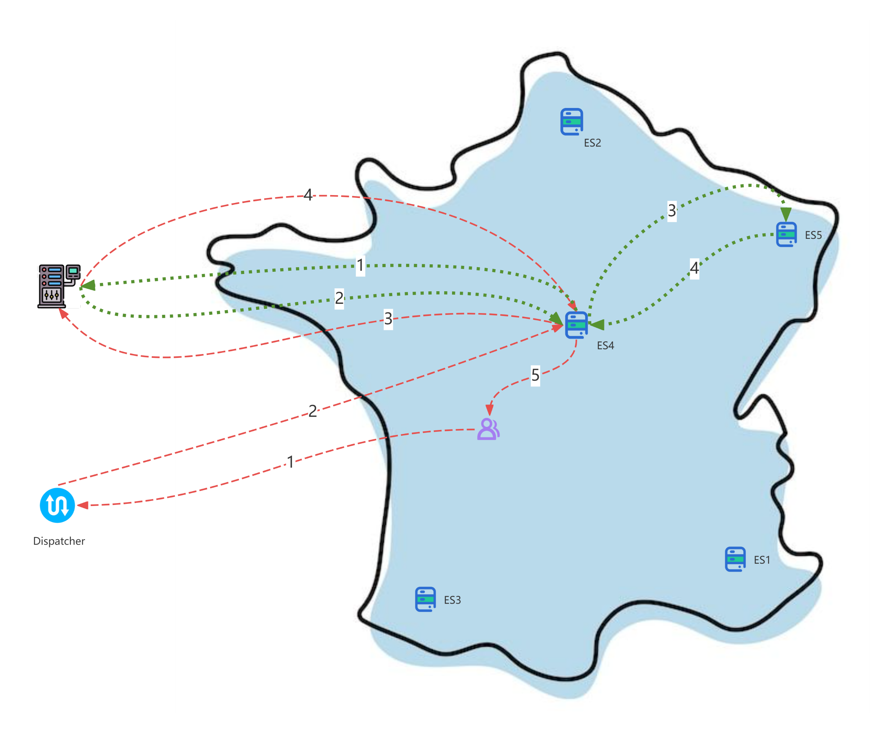
SDN-enabled F-FDN
Envisaged operation
Red dotted line: customer request processing flow
Green dotted line: video scheduling processing flow
Outline France map downloaded from https://www.istockphoto.com/

Slide 10
SDN-enabled F-FDN
Details of video streaming
Video stream processing sequence
Server : encode (ex. H264, H265, etc) → send (ex. RTP, QUIC, etc)
Client : receive → decode (corresponds to the encode method) → assemble data packets
Video stream control
Client clicks play, pause, next episode, etc. (ex. RTSP)

Slide 11
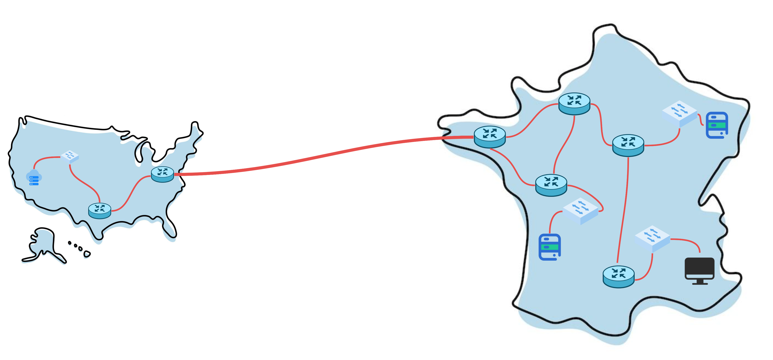
SDN-enabled F-FDN
Global view
Submarine fiber optic cables
Outline France and America map downloaded from https://www.istockphoto.com/

Slide 12
NEXT WEEK
Complete the solution
Write the state of art and the survey

